Slide 1
B2B Buyer Pyramid of Needs and Buyer’s Persona Templates
This document provides a blueprint for determining a B2B buyer’s needs. Beyond a simple demographic and pain point formula found in traditional buyer’s persona templates, it includes templates to help define needs based on 40 elements of value.
The 40 elements are based on work published in the Harvard Business Review, and a study by Bain and Company. The Bain and Company research specifically looked at the IT infrastructure and commercial insurance segments. In this document, the ten highest value elements are denoted with a green star. An individual seller may find that other elements are most important to their buyers.
Part 1 contains templates to determine how your solution addresses needs important to your prospect. This includes both your prospect’s company and personal needs.
Part 2 contains templates to map your prospect’s needs to your ability to satisfy them. Copy the template as many times as needed to build personas for the decision makers and influencers at your prospect company.
If you have not done so already, please read this article for a full explanation of the B2B Pyramid of Needs and the HBR research.
Need help? Contact us by visiting www.towncriergroup.com or send an email to info@towncriergroup.com

Slide 2
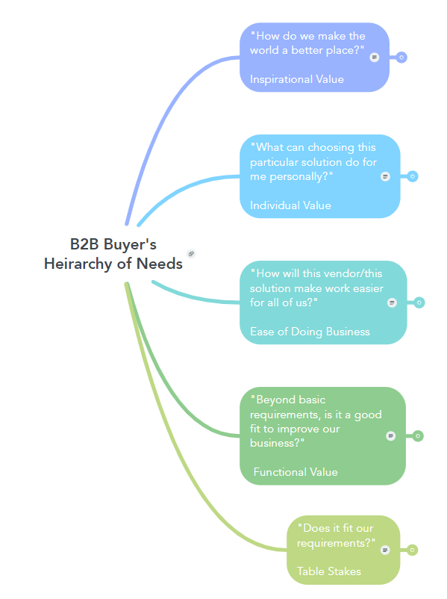
These values may come from the buyer's personal hopes and dreams for the future, from the company's own stated mission, or a combination of both.
These are benefits the buyer at the B2B may personally seek to gain. Although they don't show up in a request for bid, they can have a subtle influence on a decision maker.
This covers many aspects that increase the acceptability of a solution. These encompass benefits that apply to the business as a whole. Some of these are easy to qualify and therefore nonsubjective, others are not.
These are qualities that provide benefits in terms of saving time or money. Most of these are easy to quantify and therefore nonsubjective.
These are specifications the solution must meet in order to be viable for the buyer. They are nonsubjective. Either the solution meets the criteria, or it doesn't.

Slide 3
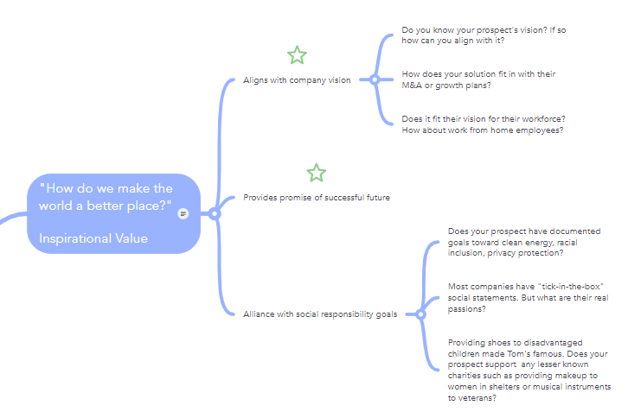
Our Value | Proof Points
Example: secure, flexible database segmentation supports multiple business units | Link to product marketing article describing segmentation scheme

Slide 4
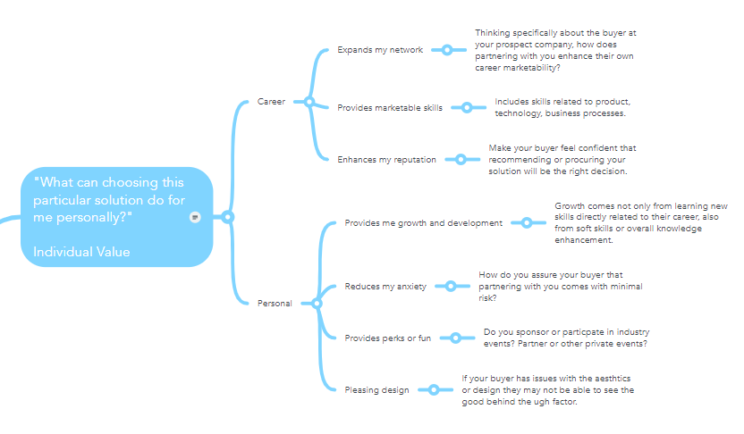
Our Value | Proof Points

Slide 5
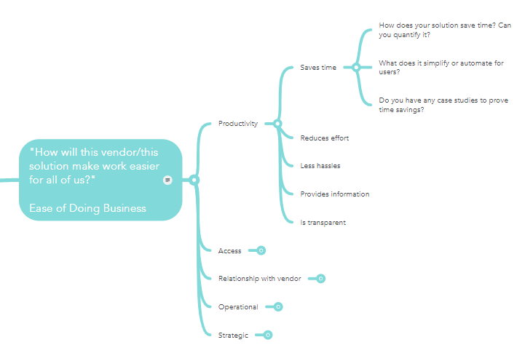
Our Value | Proof Points

Slide 6
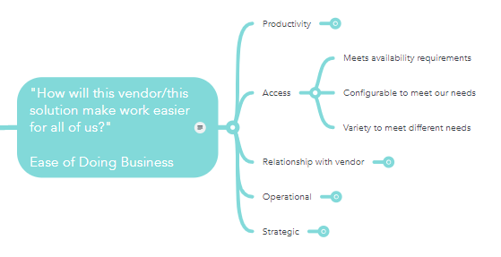
Our Value | Proof Points

Slide 7
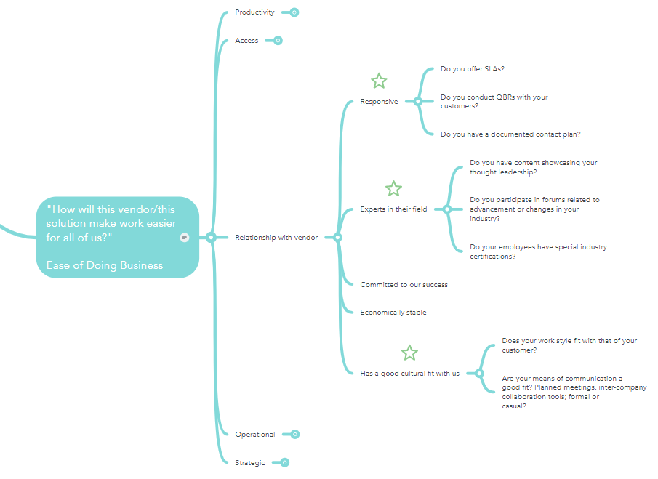
Our Value | Proof Points

Slide 8
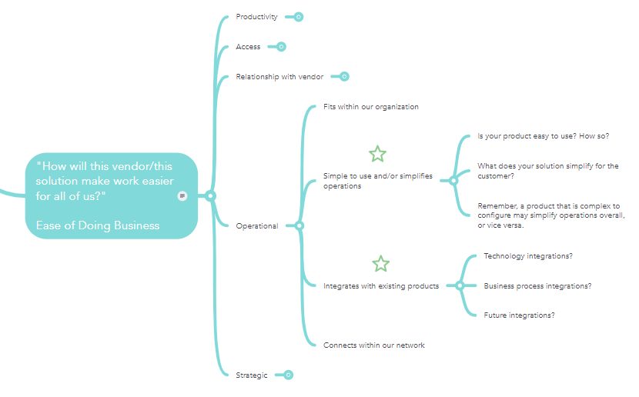
Our Value | Proof Points

Slide 9
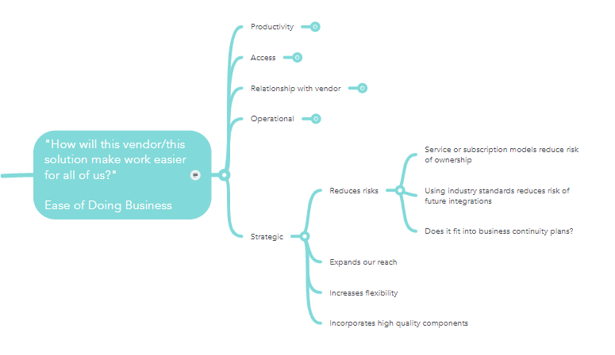
Our Value | Proof Points

Slide 10
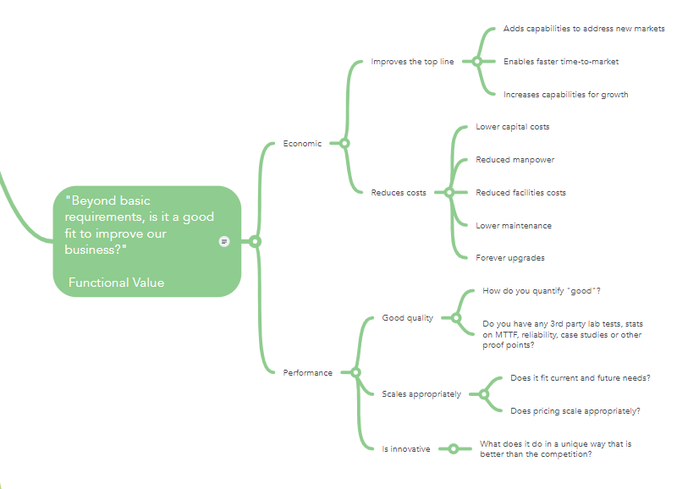
Our Value | Proof Points

Slide 11
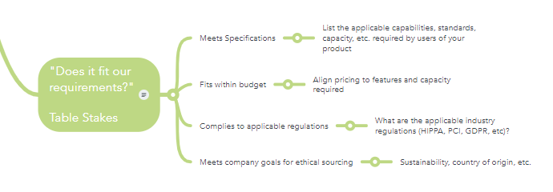
Our Value | Proof Points

Slide 12
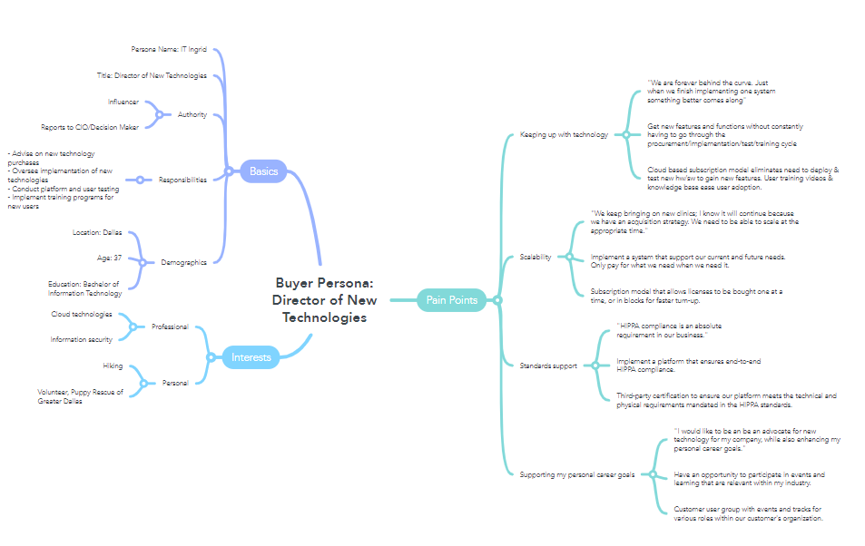
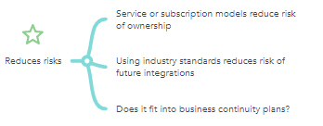
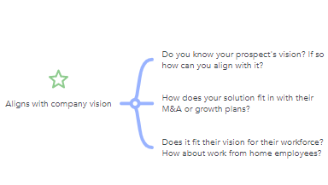
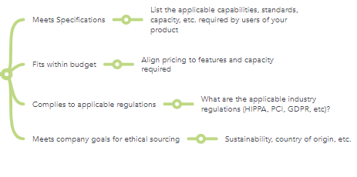
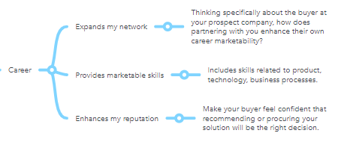
Example: mapping prospect company & buyer’s personal needs

Slide 13
Persona NAME (duplicate template as needed)
Persona | Name
Title
Authority
Responsibilities
Education
Location
Personal Demographics
Professional Interest
Professional Interest
Professional Interest
Personal Interest
Personal Interest
Pain Point | Business Goal | Our Value | Proof Points
©Town Crier Marketing Group, Inc. Need help or a more flexible format? Contact us www.towncriergroup.com v2021.1

Slide 14
Persona NAME (duplicate template as needed)
Persona | Name
Title
Authority
Responsibilities
Education
Location
Personal Demographics
Professional Interest
Professional Interest
Professional Interest
Personal Interest
Personal Interest
Pain Point | Business Goal | Our Value | Proof Points
©Town Crier Marketing Group, Inc. Need help or a more flexible format? Contact us www.towncriergroup.com v2021.1

Slide 15
Town Crier Marketing Group provides marketing services to B2B technology companies looking to grow their brands and their revenues through cutting-edge digital and content marketing strategies.
Drawing on extensive experience working with companies from Fortune 500 to startups, Town Crier has expertise in all areas of online as well as offline marketing and specializes in designing solutions to get maximum results at minimum spend.
To do this we rely on time-tested processes and tools, along with a big dose of creativity, and offer transparent pricing so you know the cost right up front.
Whether you are looking for help on a specific initiative or to outsource or augment your marketing team across the board, Town Crier will deliver on time, on budget and on promise.
www.towncriergroup.com/contact-us/

